Slide 1
Network Security
Mr. Manoj Gautam
ME(Computer)
RHCE, CCNA, CCAI, MCSE

Slide 2
Network Security: What it is ??
National Security Telecommunications and Information Systems Security Committee (NSTISSC)
Network Security is the protection of Information and systems and hardware that use, store, and transmit that information.
Network Security encompasses those steps that are taken to ensure the confidentiality, integrity, and availability of data or resources.

Slide 3
Network Security driving factors.
Internet Connectivity is 24/7 and is Worldwide.
Increase in Cyber Crime.
Proliferation of Threats.
Impact on Business and Individuals
Sophistication of Threats.
Legislation and Liabilities

Slide 4
Impacts
Decrease in Productivity
Loss of Sales Revenue
Release of Unauthorized sensitive data
Threat of Trade secrets or formulas
Compromise of Reputation and trust
Threat to environmental and safety systems
Loss of time

Slide 5

Information Security Goals

Slide 6
Confidentiality
Prevent the disclose of sensitive information from
Unauthorized people
Resources
Process

Slide 7
Integrity
The protection of system information or processes from intentional or accidental modification.

Slide 8
Availability
The assurance that systems and data are accessible by authorized users when needed.

Slide 9
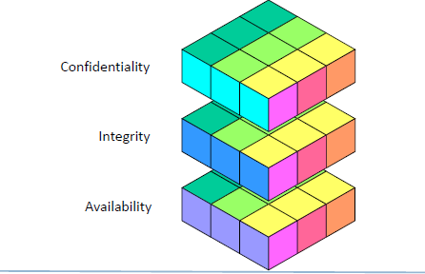
Information security Properties

Slide 10
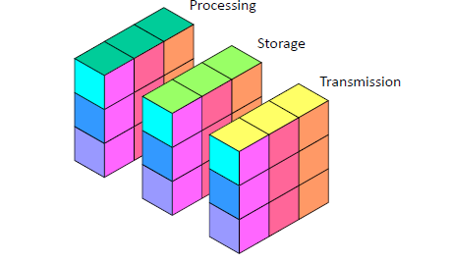
Information States
Processing
Storage
Transmission

Slide 11
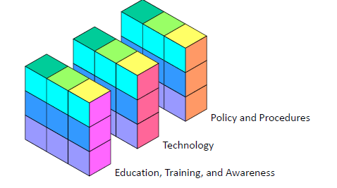
Information Security measures.
Education, Training and awareness
Technology
Policy and procedures

Slide 12
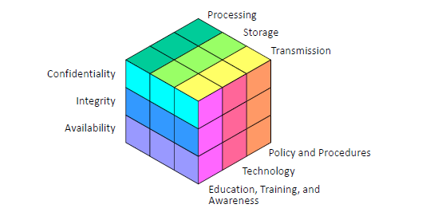
Information Security Model

Slide 13
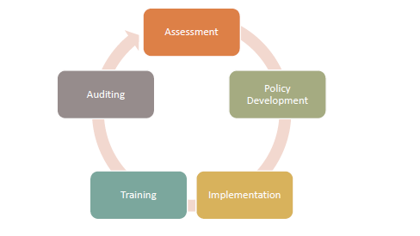
Information Security Life cycle

Slide 14
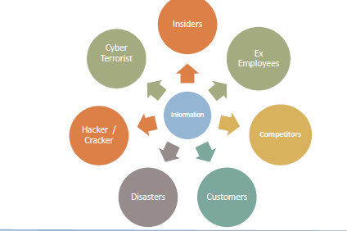
Who attacks on Information

Slide 15
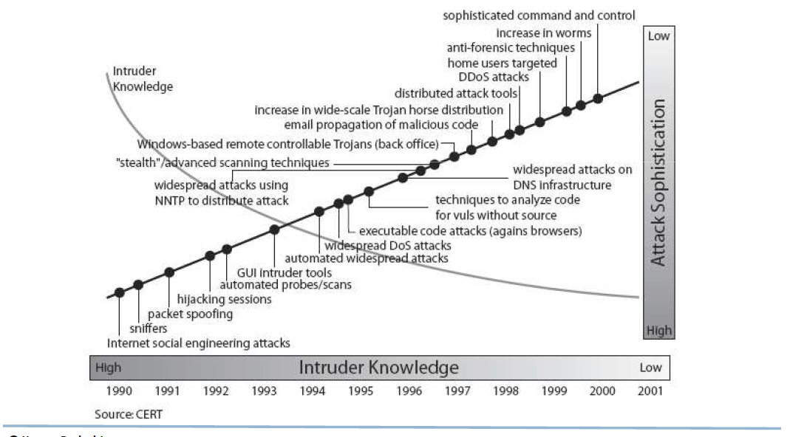
Intruder Knowledge vs Attack Sophistication

Slide 16


